Slide 1
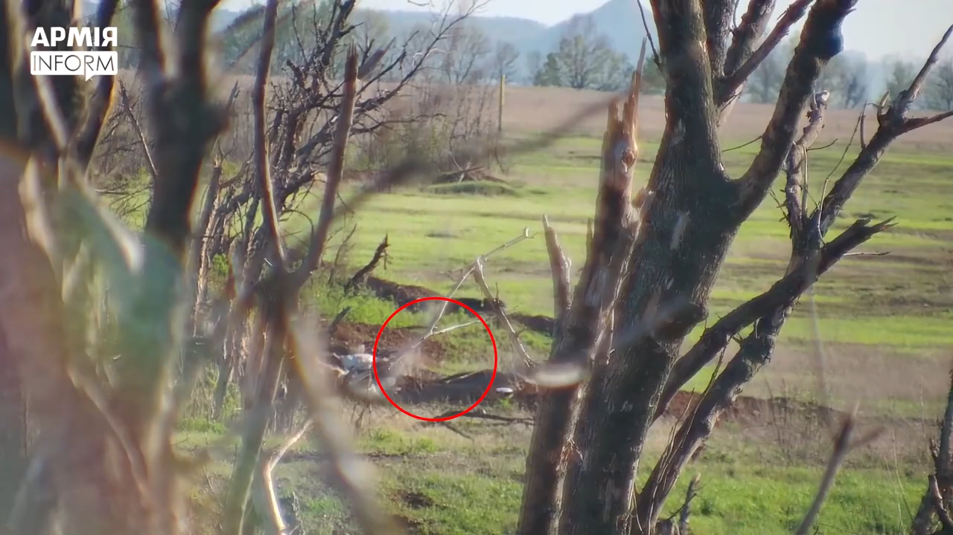
Remote mining by POM-2 by the Russian Forces on Temporarily occupied territories (TOT) of Ukraine

Slide 2
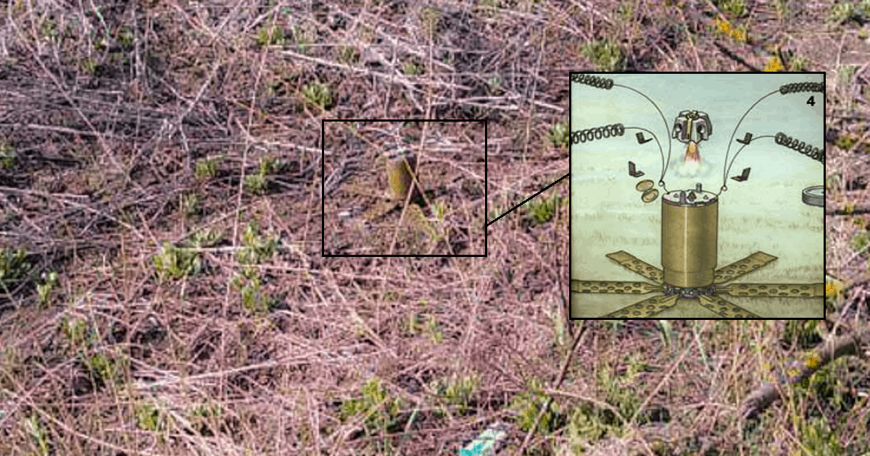
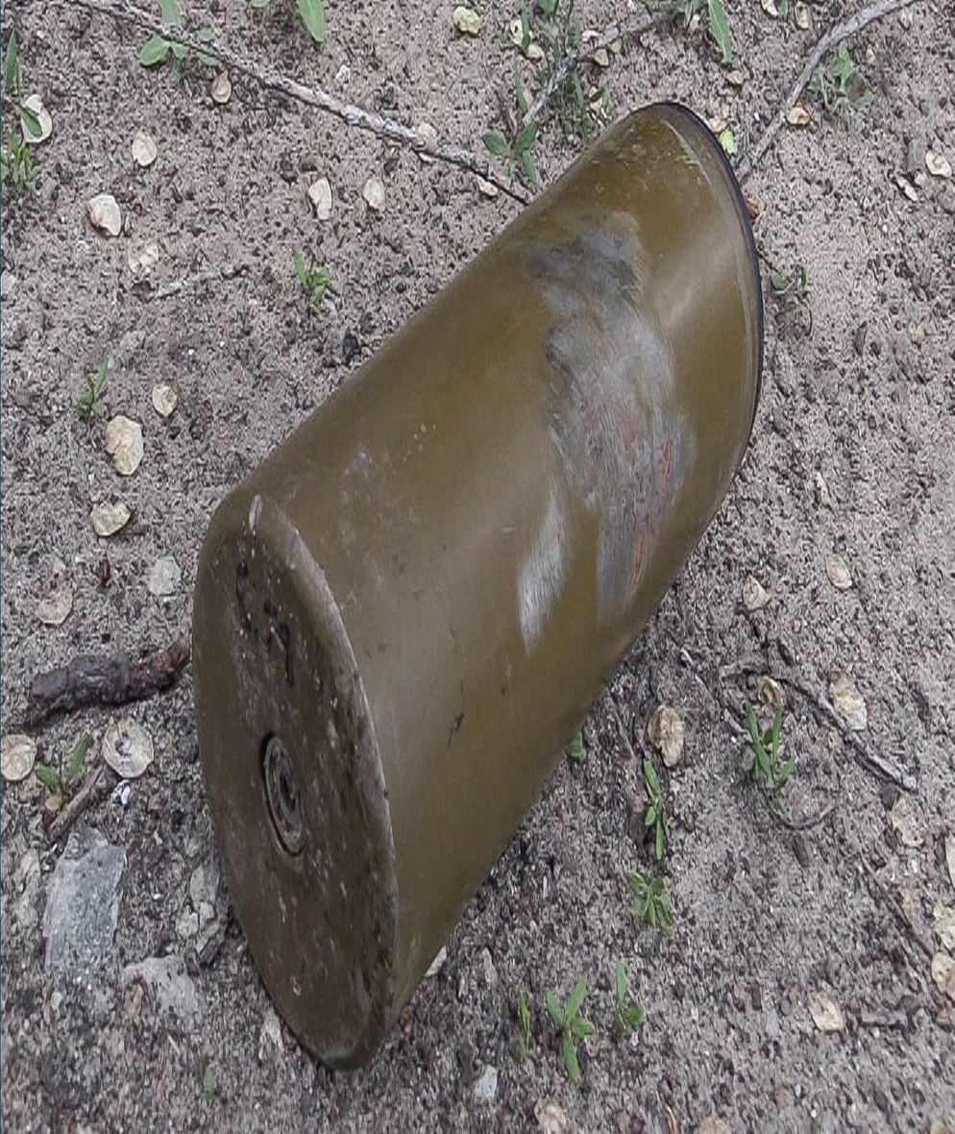
POM-2 mines used by the Russian Armed Forces in Donbas region

Slide 3
EXAMPLES OF THE APPOINTMENTS OF RUSSIAN CITIZENTS TO THE RUSSIAN OCCUPATIONAL ADMINISTRATIONS IN CERTAIN AREAS OF THE DONETSK AND LUHANSK REGIONS OF UKRAINE

Slide 4
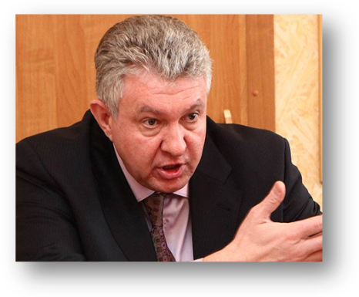
Russian Occupational Administration in Certain Areas of Donetsk Region of Ukraine (ROACADR)
Vladimir PASHKOV
so-called “Deputy Prime Minister” of ROACADR
Date of birth - 4th of February 1961
Place of birth - Bratsk, Irkutsk region, Russian Federation
Citizenship - Russian Federation.
Education:
1981-1985 – Pacific maritime college named after S. Makarov;
1996 – Bratsk industrial institute.
Military service:
1985-1993 – Navy officer. Initial post – navigator of nuclear submarine “Bratsk”.
Civilian activity:
1993-2002 – administration work in Bratsk;
2005-2006 – vice mayor of Bratsk;
2009-2012 – administration of Irkutsk region;
2012-2014 – vice governor of Irkutsk region;
2015 – President of “Fund of international humanitarian projects support” which is registered in Moscow.
Founder of “International settlement bank” fund of Southern Ossetia which operates as a correspondent bank with ROACADR / Russian occupational administration in certain areas of Luhansk region of Ukraine (ROACALR), which allows for the avoidance of any international payment system.
“Fund of international humanitarian projects support” is used to fill the budget of ROACADR / ROACALR disguised as “Russian Federation government financial aid”
April 2017 – April 2019 general director of closed joint stock company “Vneshtorgservis”;
April 18, 2019 – so-called “Deputy Prime Minister” of ROACADR.

Slide 5
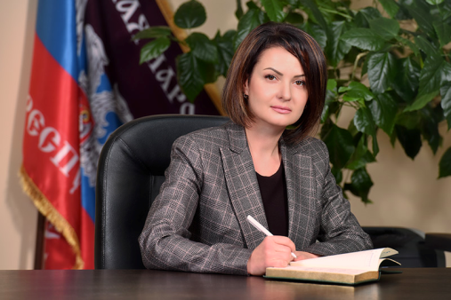
ROACADR
December 2018 - present
Yana CHAUSOVA
so-called “Minister of Finance” of ROACADR
Date and place of birth: 22.09.1980 Kursk, Russia
Positions in Russia
2012 – candidate in elections for the Kurchatov City Council
Positions in ROACADR
Sept 11, 2018 – so-called chief of audit department of Executive Office of the Head of ROACADR
Dec 3, 2018 – present – so-called “Minister of finance” of ROACADR

Slide 6
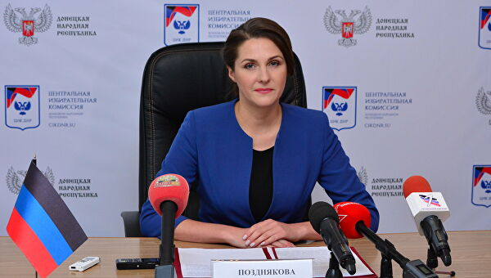
ROACADR
September 2018 – present
Olga POZDNYAKOVA
so-called “Head of the Central Election Commission” of ROACADR
Data and place of birth: 30.03. 1982, Shakhty, Rostov region, Russia
Positions in Russia
Member of the “Edinaya Rossiya” party
Deputy of City Council in Shakhty
Positions in ROACADR
2014 – so-called coordinator of humanitarian aid from Russia to ROACADR
2015 –employment in so-called “Ministry of Information” of ROACADR
2015 – employment in so-called Committee on social aspects for the “Novorossiya” people’s front (so-called political organization)
2015 – so-called Chief of section, Central Executive Office of the “Donetskaya Respublika” public movement (so-called political organization)
2016 – so-called Deputy Chief of the Central Executive Office of the “Donetskaya Respublika”
2018 – so called Chief of the office of the People’s Council
September 2018 – present – so-called “Head of the Central Election Commission”

Slide 7
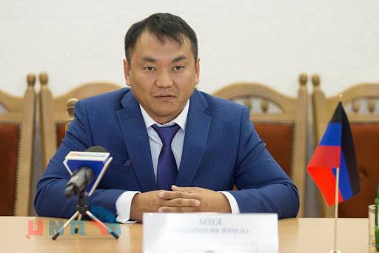
ROACADR
December 2018 - present
Andrey KIM
So-called “Head of the Supreme Court” of ROACADR
Data and place of birth: 23.05.1977, Russia
Positions in Russia
Chief of investigation section in Volgodon, Rostov Region
Procecutor’s office of the Investigation Committee of Russia (Kislovodsk, Stavropolskii Region, Russia)
Positions in ROACADR
2015-2018 – so-called chief of section, “Supreme Court” of ROACADR
Dec 3, 2018 – present – so-called “Head of the Supreme Court” of ROACADR

Slide 8
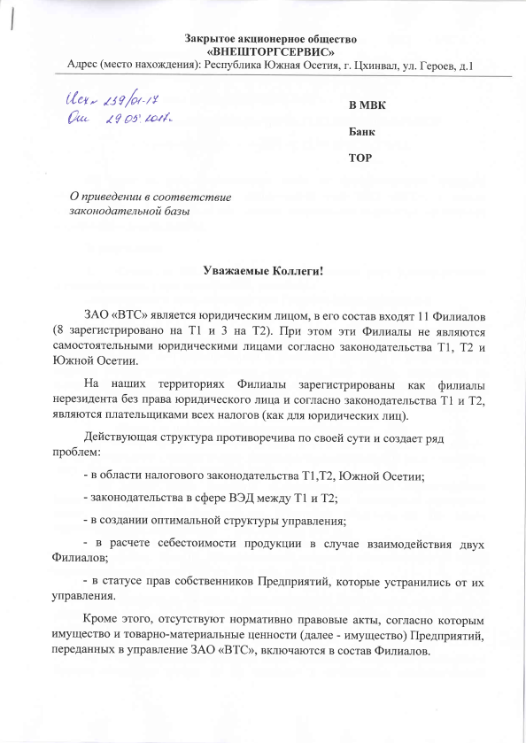

Slide 9
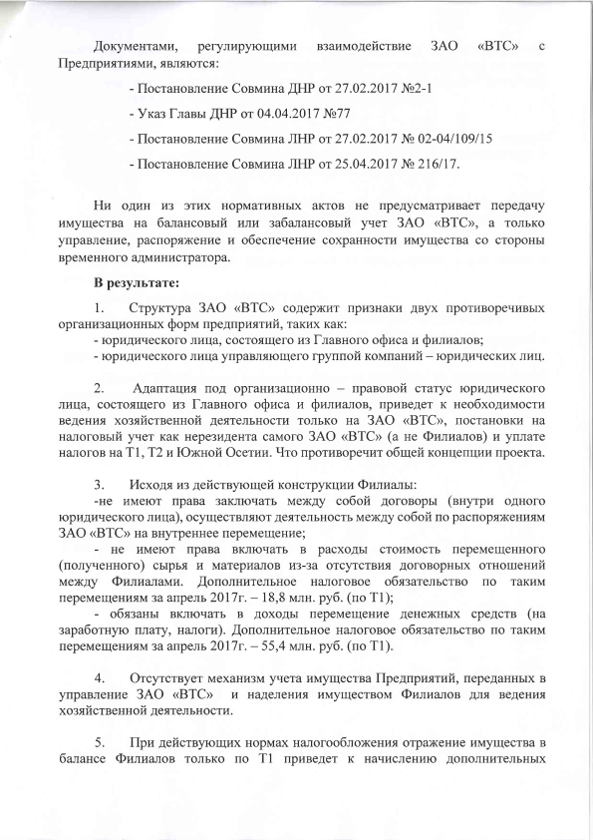

Slide 10
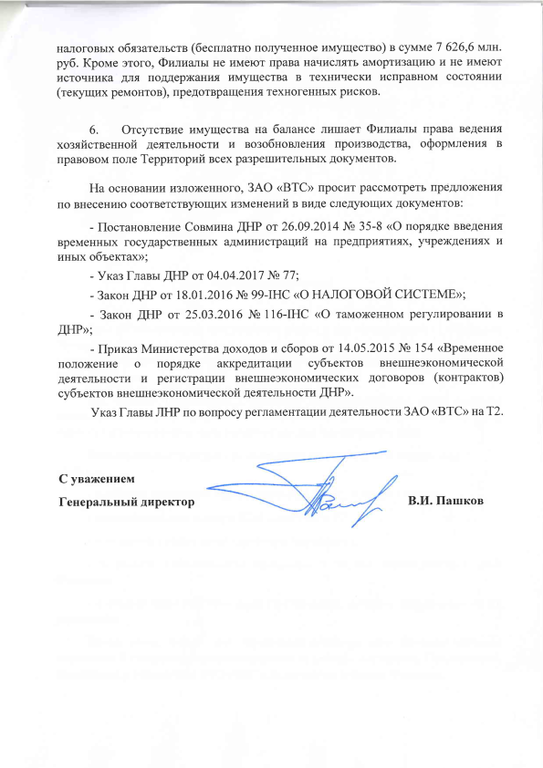

Slide 11
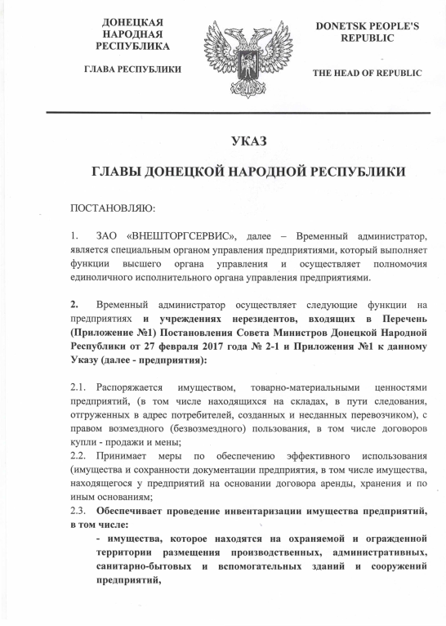

Slide 12
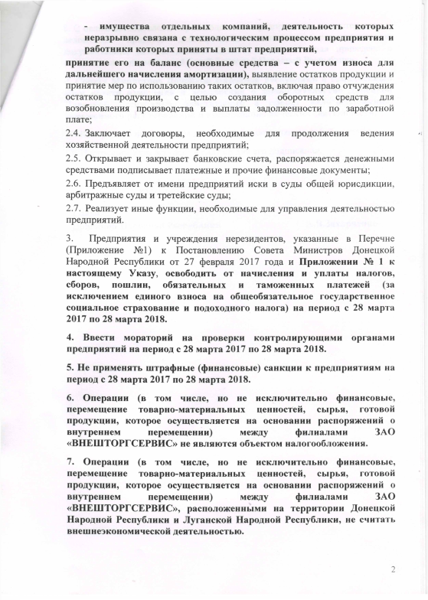

Slide 13
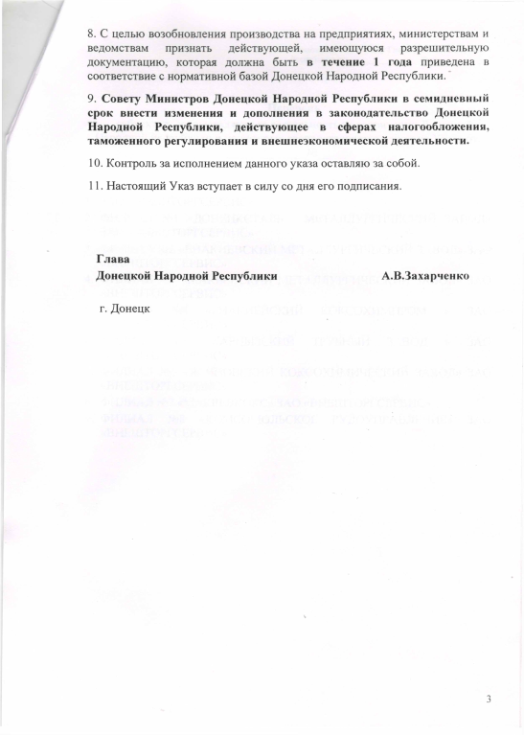

Slide 14
