Slide 1

Russian Hybrid War against Ukraine: 2014-?
Oleksandr Lytvynenko,
Director of the National Institute for Strategic Studies

Slide 2

Genteelism
Rather Unclear and Too Wide Concept
A Comfortable Basket for a Wide Range of
Hostile Activities
Deeply Rooted in Russian Strategic Culture
Complex and Adaptive Use of Political, Economic, Informational (PsyOps and Cyber) and Military Means for Achieving Political Ends
Preparatory Remarks for
Hybrid Warfare

Slide 3

Russian Goals on This Stage
To Prevent Ukraine from Joining NATO&EU
To Keep Ukraine in a Buffer Zone
To Restore Russian Influence in Ukraine
To force Ukraine to recognize Russian occupation of Crimea
The Strategic Course of the RF with Member-States of CIS 1995
The National Security Strategy of the RF 2015
The Concept of the Foreign Policy of the RF 2016

Slide 4
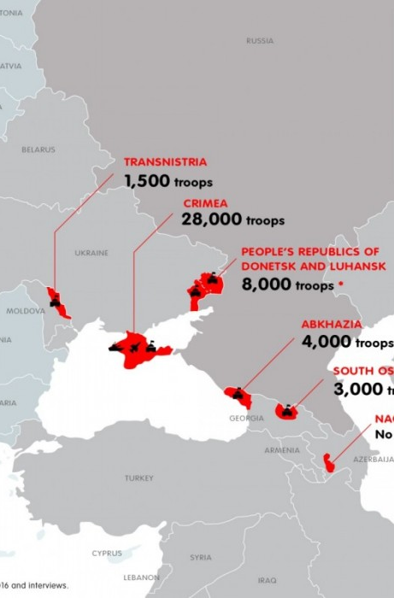
Russian-Ukraine Relation
after 2014
A Manageable Confrontation (Tenses) in All Domains (Political, Economic, Informational and Military)
Direct Illegal Russian Occupation of Crimea
Russian Proxy War in Donbas
Main objective is to destabilize Ukraine and destroy resilience
Prolonged efforts

Slide 5

Political Domain
Diplomatic Pressure Direct and Indirect
Support for pro-Russian Political Groups inside Ukraine
Weaponizing Some Orthodox Church Organisations
Shaping and Supporting Different Subversive groups such as People Republics (Bessarabian, Kharkiv’s, Odesa’s etc.), especially 2014-2016
Constitutional Amendments on:
  the RF as a Successor State for the USSR
  Federal Territories
  Protection of Compatriots

Slide 6

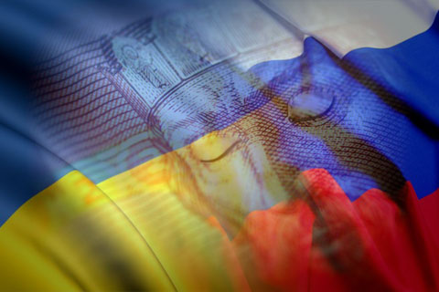
Economic Domain
Occupation of Crimea & War in Donbas
Trade Limitation
Limitation of Transit to Caucasus and Central Asia
Economic Sanctions
GDP of Ukraine (US Dollars 2010)
2013 – $143,751 billions
2019 – $135,537 billions
(with the temporarily occupied by Russia Crimea and Donbas)
(WB data)

Slide 7

Informational Domain
Propaganda
Cyber
TV propaganda
Internet propaganda, bots
Social Networks: FB, Telegram, Vkontakte, Odnoclassniki
Fakenews
Malware, Viruses etc.
Critical Infrastructure
Energy Grid
Transport – Railways, Ports, Airports
Public Institutions
Petya, NonPetya
Hacking

Slide 8
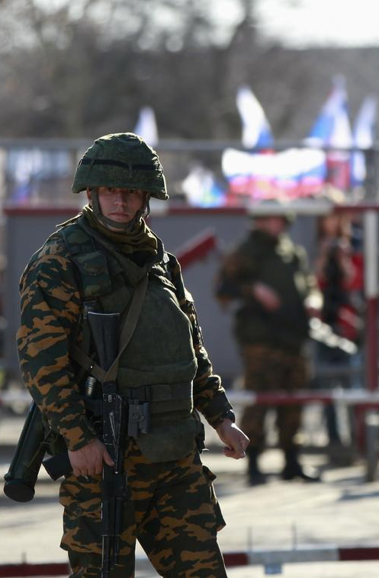
Military Domain
After 2015 Russian policy had changed
War of Attrition and Exhaustion
Russian military Build Up with 2 objectives:
  Securing National Frontiers
  Offensive
8 Army, 4 Army of Air Forces and Air Defense the South Military District
20 Army of the West Military District
Crimea:
  Strike Capabilities (Missiles) based on Land and Sea Platforms
  Logistic base for Russian activities in Syria, MENA and Balkans
Using the Territory of Belarus
Freedom of Navigation in Black and Azov Sea, Kerch Strait Incident 28/11/2018

Slide 9
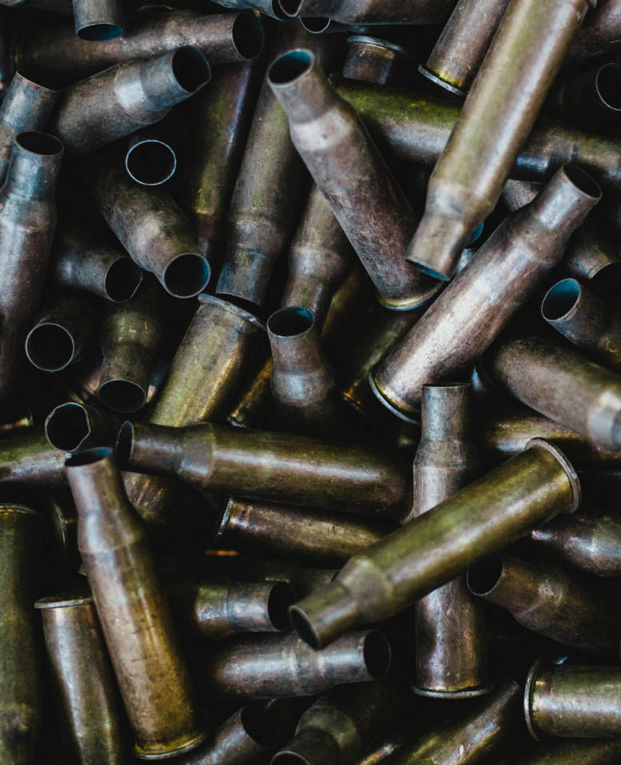
A Protracted Proxy War of Attrition
  Psychological Exhaustion
  Losses and Military Expenditure
1st & 2nd Arm Corps
C2 – 8 Field army – the South Military District – General Staff of the RAF
Intensity of shelling – about 60-80 per week
For 6 years of conflict – 41-44 000 of victims, 13,2 000 killed, more than 3000 civil people killed
Donbas War: Military Aspect

Slide 10
Minsk agreements 2014-2015
Integration to the RF
We are Approaching to the Turning Point
Abkhazian scenario or Nagorny Karabakh scenario
Donbas War:
Political
Aspect

Slide 11
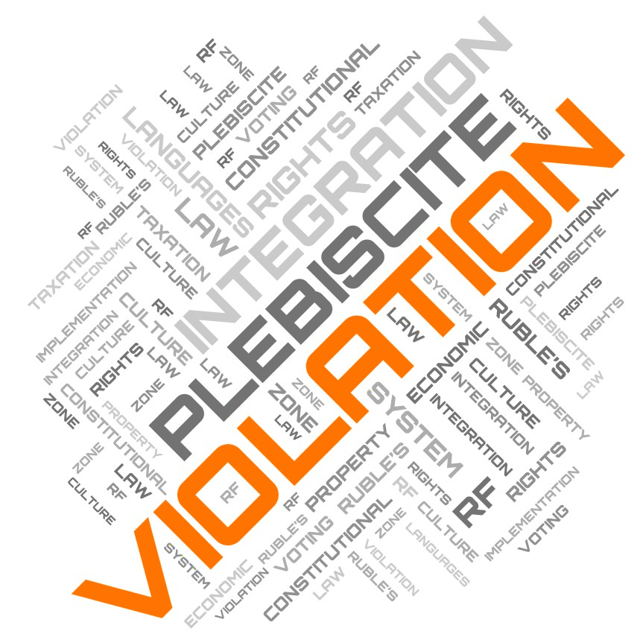
Integration to the RF
Distribution of Russian Passports – more than 200 thousands now
Voting on Russian Constitutional Plebiscite (1 Jul 2020)
Implementation of Russian Law System
Economic:
  Ruble Zone
  Violation of Property Rights since 2014
  Taxation
Culture and Languages

Slide 12

Q&A

